Slide 1
Domain Generalization for CSI Compression
Cristian J. Vaca-Rubio, PhD.

Slide 2
EVERYTHING IN 2 MINUTES
Data understanding → Angular vs. Delay Domain: Which one matters
ML insights → How does domain shift disrupt learning?
Generalization → How can we fight back against domain shift?
the most?
2/30

Slide 3
Data understanding
3/30

Slide 4
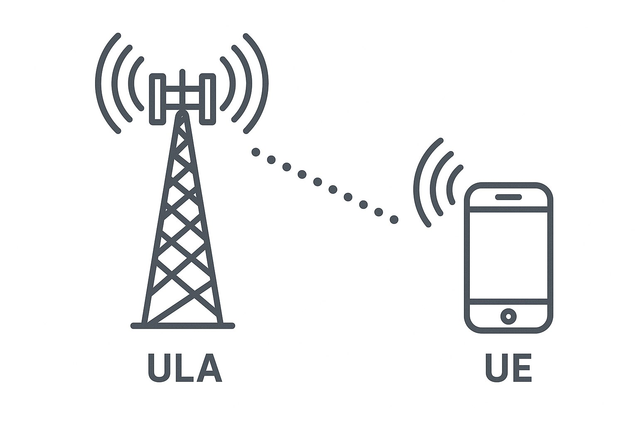
Dataset Overview
Dataset: COST2100 (Indoor & Outdoor), preprocess per CSINet
Indoor → picocellular scenario at 5.3 GHz band, 20x20 m scenario
Outdoor → rural scenario at the 300 MHz band, 400x400 m scenario
Uniform Linear Array (ULA) with 32 antennas and 1024 subcarriers
CSI in truncated delay–angle (32×32) domain after 2D DFT
Values normalized to bounded range [0, 1]
Comparing Indoor vs Outdoor CSI structure and understanding their main differences
4/30

Slide 5
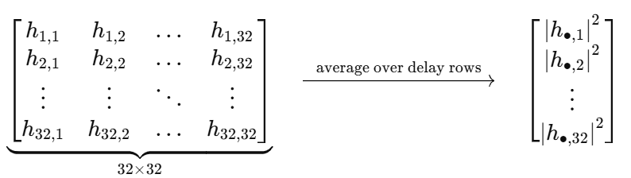
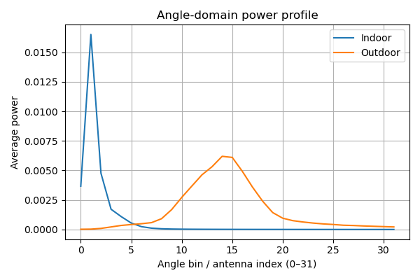
Why Angles Matter?
Indoor CSI (5.3 GHz Picocell)
High angular sparsity
Dominant LOS and small spatial spreads
Outdoor Rural CSI (300 MHz)
Broad angular distribution
Widely separated scattering clusters and diffraction-induced angular diversity
Indoor vs Outdoor = angular distribution mismatch
5/30

Slide 6
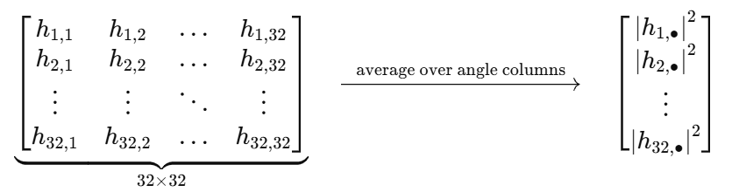
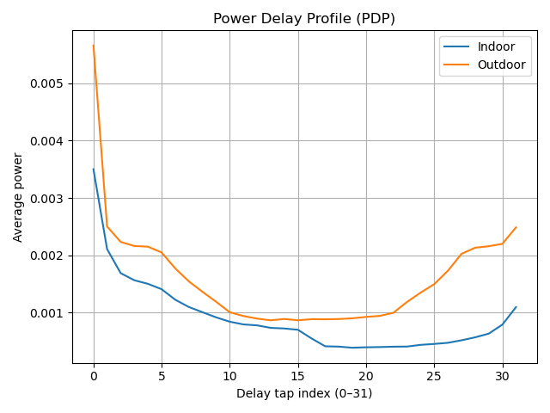
Does Delay Matter as Much?
Early delay taps (0–4) concentrate most of the power
LOS (indoors)
Strong NLOS components such as diffraction and ground reflections (outdoor)
Indoor and outdoor channels exhibit very similar decay patterns
Outdoor samples retain slightly more late-tap activity
Delay statistics barely shift
6/30

Slide 7
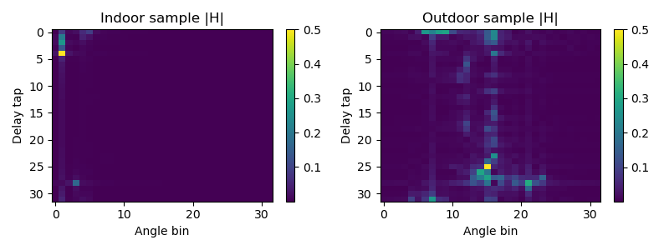
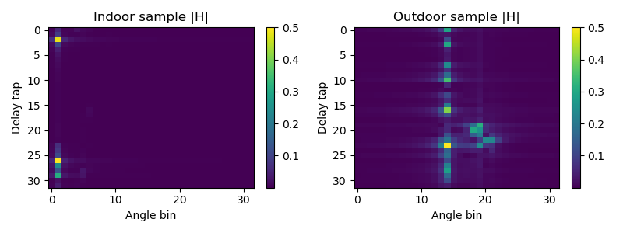
Heatmap Examples
Indoor CSI exhibits highly localized structure
Energy concentrated in just 1–2 angle bins and a few delay taps
Indoor samples display very low variability
Outdoor CSI shows multiple clusters distributed across both delay and angle
Less focused in angle
Outdoor samples vary significantly
Indoor↔Outdoor structural changes cause a strong domain shift that ML models cannot generalize across
7/30

Slide 8
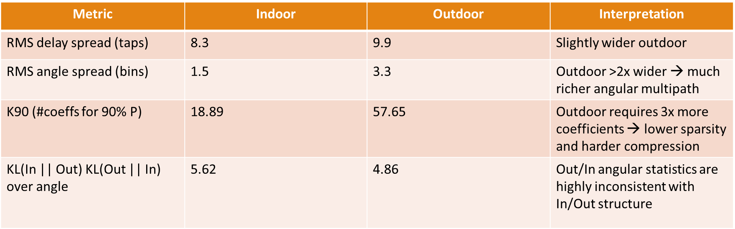
Quantitative Difference Indoor & Outdoor CSI
Angular statistics (spread, sparsity, and KL divergence) show a strong structural domain shift
8/30

Slide 9
Role of Sparsity in CSI Compression & Generalization
Sparsity helps in-domain reconstruction
Indoor CSI is highly structured and consistent → near-perfect reconstruction
Most CSI compression methods can benefit on this sparsity
Sparsity differences hurt cross-domain generalization
Indoor CSI is very sparse (few angles, few delays)
Outdoor CSI is less sparse and more variable (multiple clusters, broad angles, longer delays)
Sparsity compresses, but environmental shifts break its structure
9/30

Slide 10
ML training & insights
10/30

Slide 11
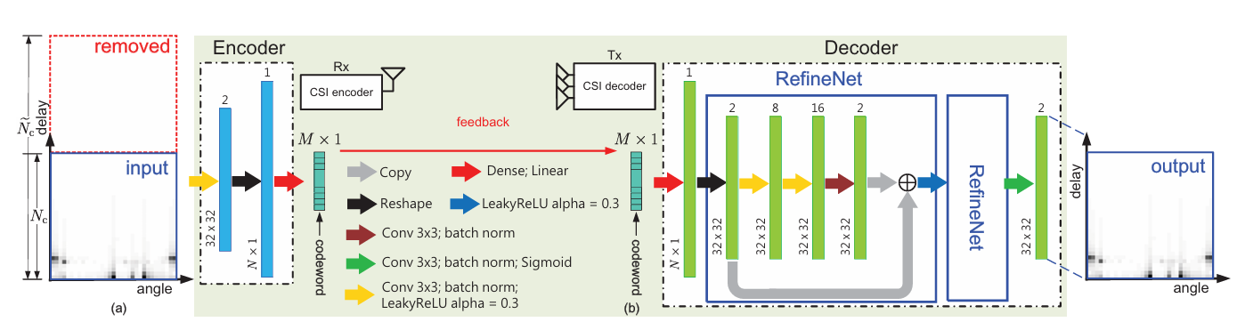
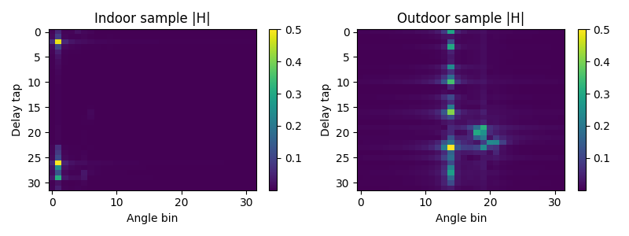
CSINet
Reimplementation of original CSINet architecture in PyTorch
11/30

Slide 12
Why Domain Shift Matters for CSINet?
CSINet learns a compressed latent representation of CSI
If the input distribution changes (indoor → outdoor), the encoder activates different patterns
Hypothesis → mismatch leads to:
Poor reconstruction
High Normalized Mean Squared Error (NMSE)
12/30

Slide 13
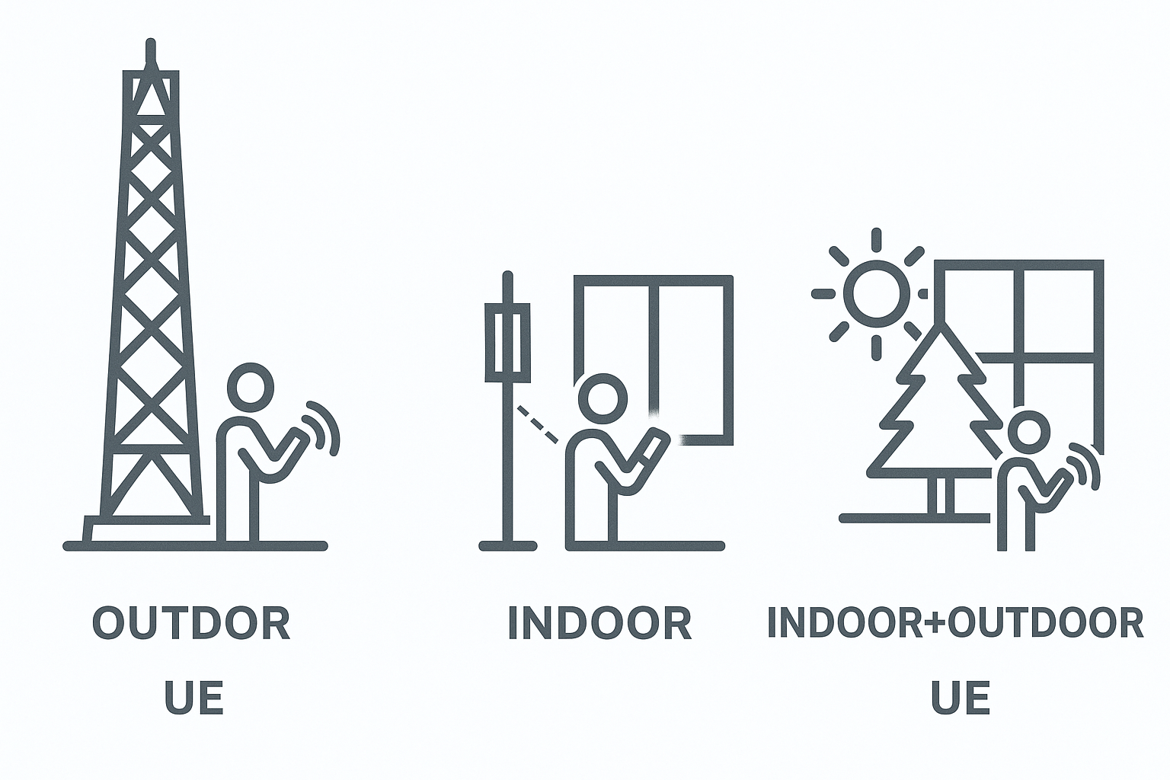
Training setup
Architecture: CSINet with same parameters
Encoder dimension: 512 (ratio ¼)
Domain options:
Train Indoor
Train Outdoor
Train Indoor+Outdoor
Splits given in train/val/test
Training by using the Mean Squared Error (MSE) function, similarly as CSINet
Selected model that minimizes validation loss
Early stopping mechanism implemented with 10 epochs patience
13/30

Slide 14
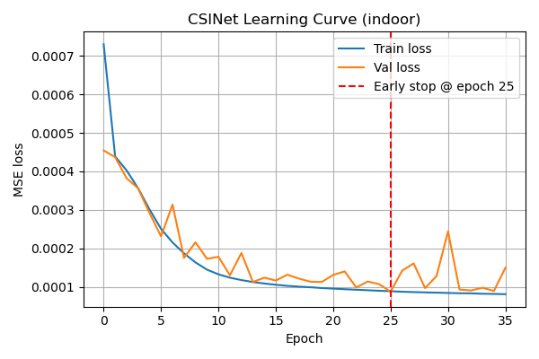
Learning Curve: Indoor Training
25 epochs
Smooth convergence
Best validation at epoch 25
Indoor data is easy to compress (low variability, compact multipath)
No overfitting behavior
14/30

Slide 15
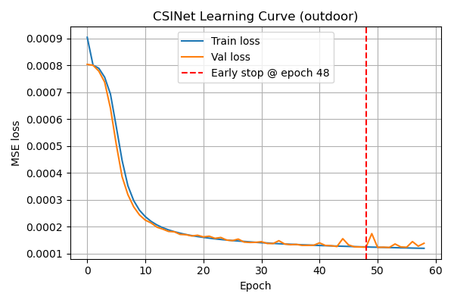
Learning Curve: Outdoor Training
25 epochs
48 epochs
Much slower convergence
Best validation at epoch 48
Outdoor CSI has wider angular spread → harder to encode
No overfitting behavior
15/30

Slide 16
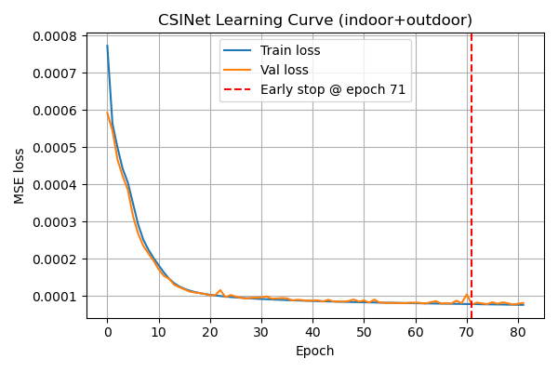
Learning Curve: Indoor+Outdoor Training
25 epochs
48 epochs
71 epochs
Longer training until convergence
Best validation at epoch 71
Learns more general features
No overfitting behavior
Joint model learns a balanced latent space
16/30

Slide 17
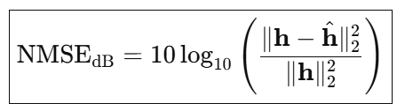
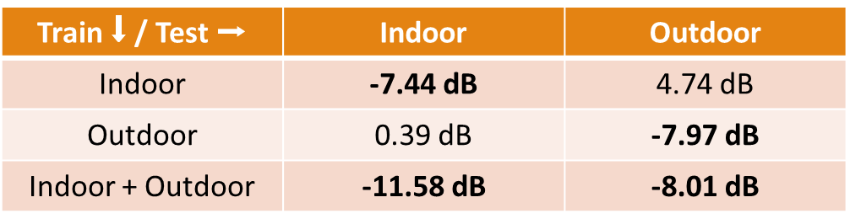
NMSE Results on Test set
Models generalize poorly across domains
A jointly trained-model achieves the best overall robustness:
The model is learning a shared structure rather than overfitting to a single environment
Indoor-only model performs great, but collapses elsewhere
Outdoor-only model generalizes slightly better than indoor-only
17/30

Slide 18
Generalization
18/30

Slide 19
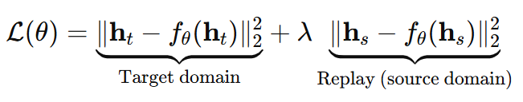
Replay Fine-Tuning Mechanism
Target-domain CSI
Target-domain CSI
Source-domain CSI
Source-domain CSI
19/30

Slide 20
Replay Fine-Tuning Mechanism
Continual learning-inspired
Motivated by settings where new environments are available after initial training
Goal: Adapt a model from a source domain Ds to a target domain Dt while preventing catastrophic forgetting on Ds
During training a mix of samples from both the target-domain and the replay (cached) source-domain
The learning is encouraged by a combined loss
20/30

Slide 21
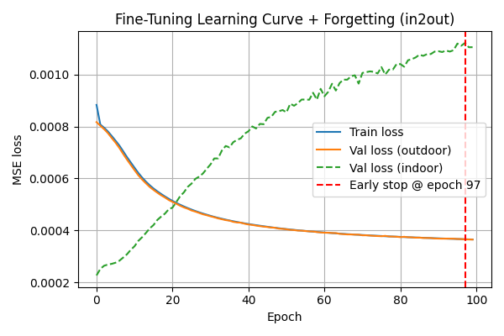
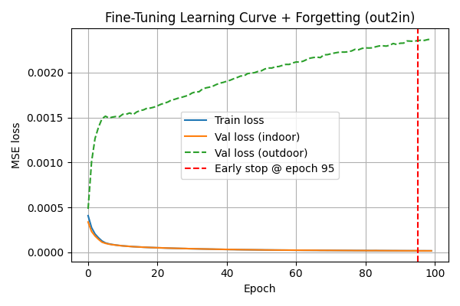
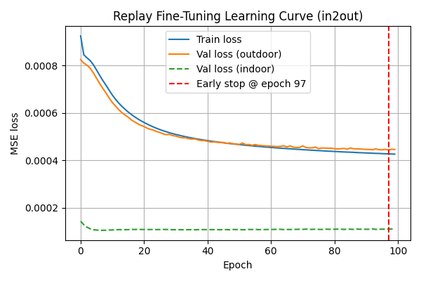
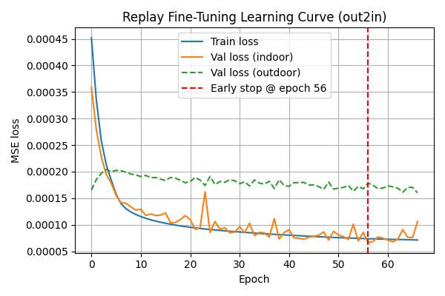
Learning Curves
Standard Fine-Tuning
Replay Fine-Tuning
21/30

Slide 22
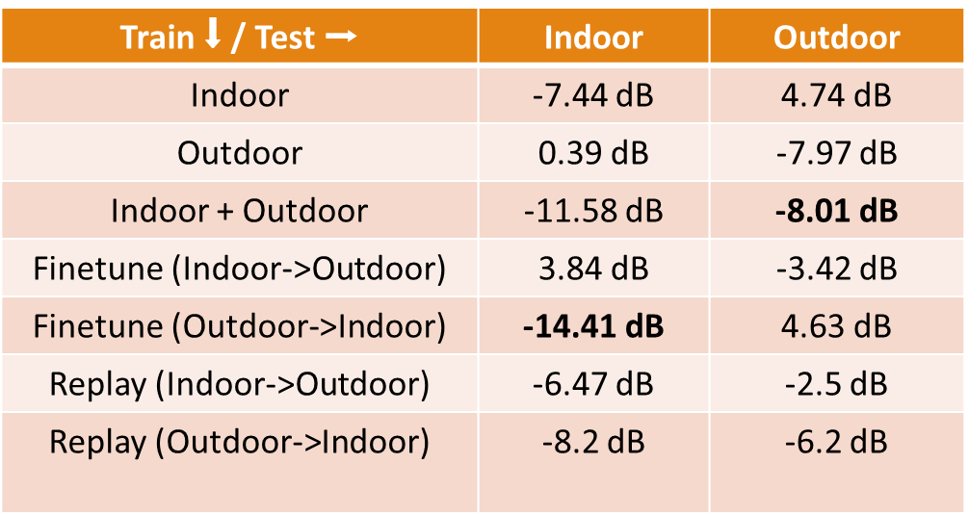
Results on Test Set
Replay fine-tuning improves cross-domain performance while reducing catastrophic forgetting
Simple fine-tuning leads to heavy catastrophic forgetting
Outdoor-trained models generalize better because Outdoor CSI is more complex; once learned, Indoor patterns are a simpler refinement
22/30

Slide 23
Domain-Aware Architecture
Phase 1
Source domain CSI decoder
Phase 1
Encoder
Frozen Encoder + Adapter
Adapter only active in Phase 2
Phase 2
ConvAdapter
Phase 2
Target domain CSI decoder
23/30

Slide 24
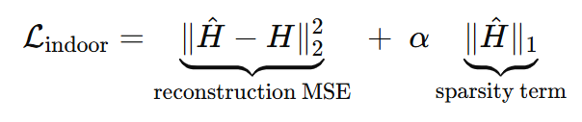
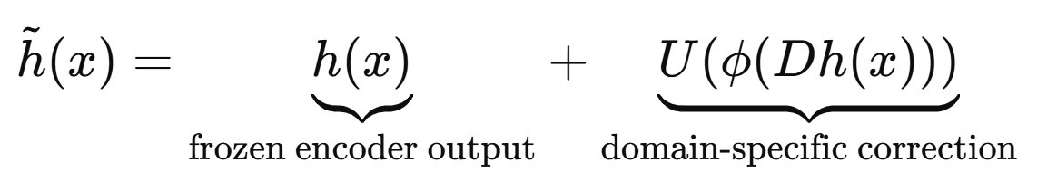
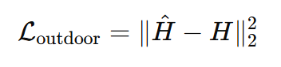
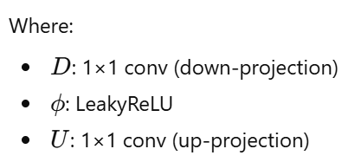
Domain-Aware Architecture
Motivated by settings where new environments are available after initial training
Goal: Adapt a model from a source domain Ds to a target domain Dt while preventing catastrophic forgetting on Ds
The catastrophic forgetting is prevented by an adaptive filter
Sparsity knowledge is also leveraged
Frozen Encoder (shared) + Lightweight Adapter (trainable)
Active only during target-domain adaptation (Phase 2)
ConvAdapter
24/30

Slide 25
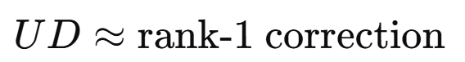
Intuition Behind Adaptive Filter
The encoder is frozen -> preserves performance on source domain
The adapter applies a small, low-rank residual update
This lets the model slightly change the feature space for the new domain
Without overwriting what was learned before → no catastrophic forgetting
25/30

Slide 26
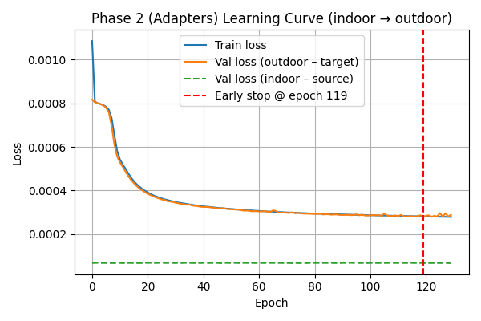
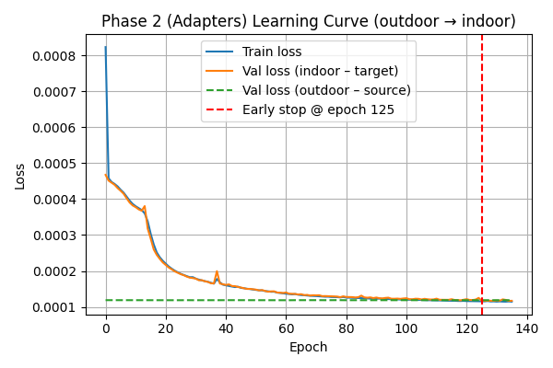
Learning Curves
26/30

Slide 27
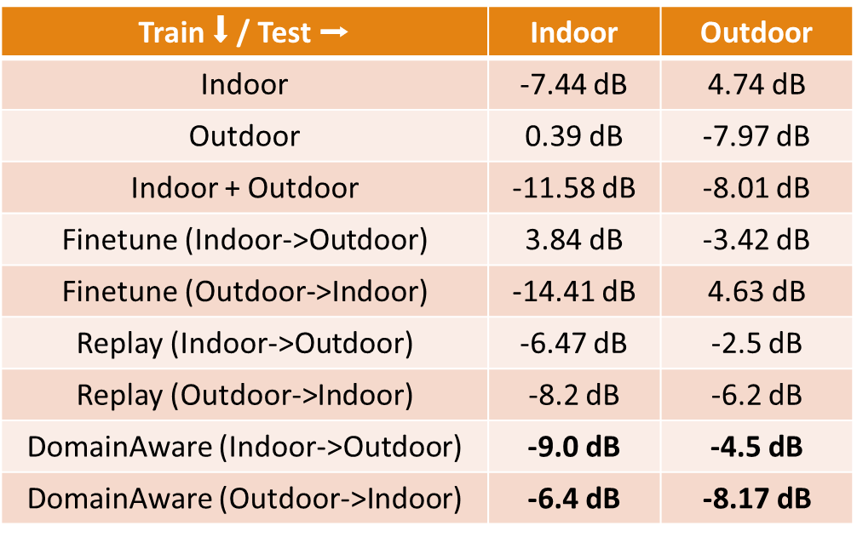
Results on Test Set
Domain-Aware improves cross-domain performance reducing catastrophic forgetting even further
27/30

Slide 28
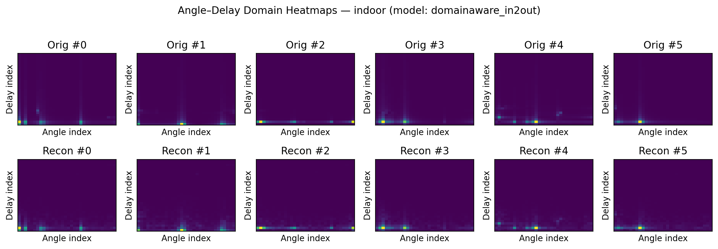
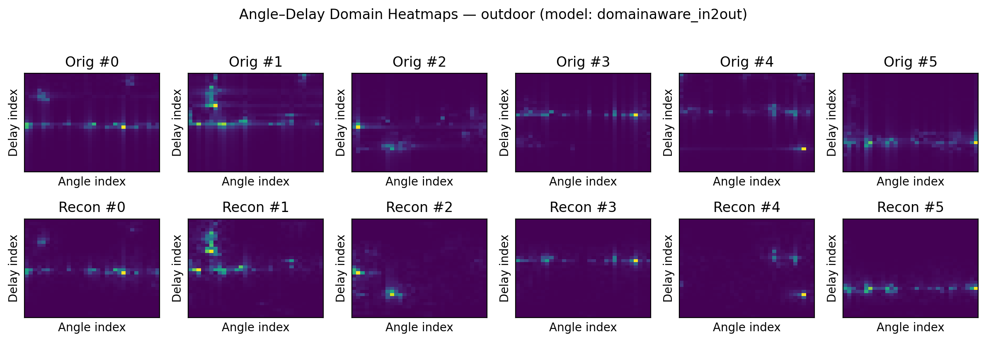
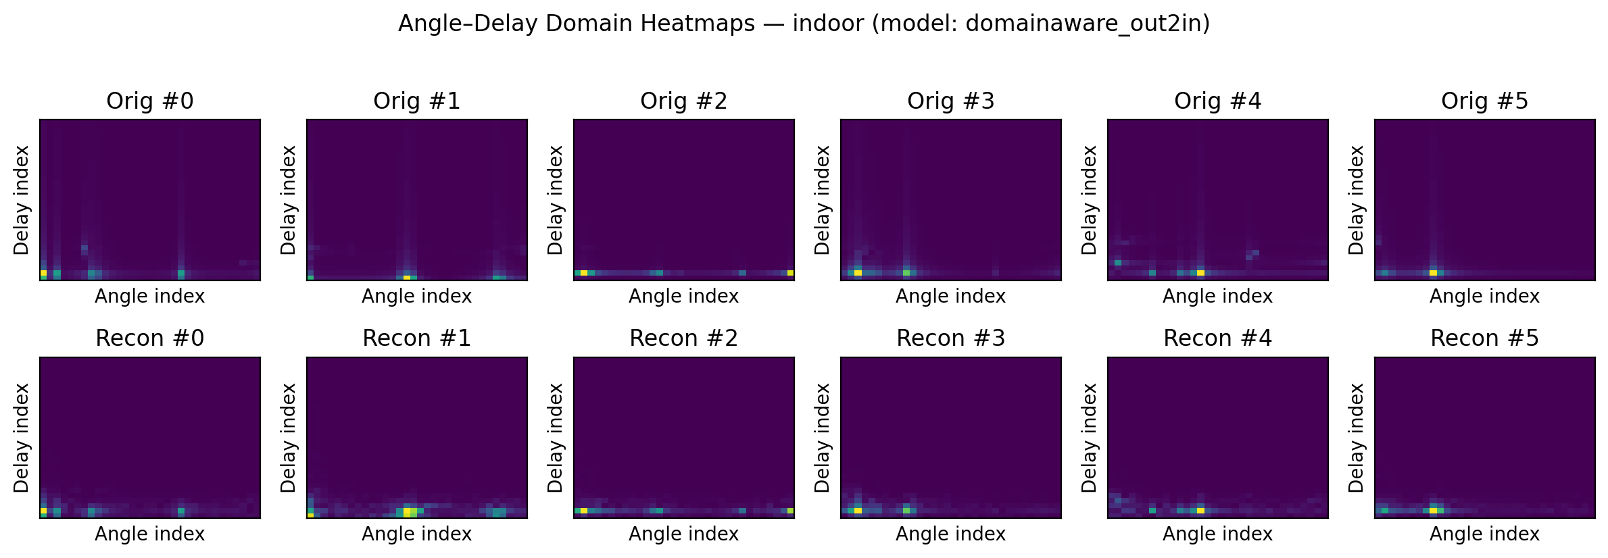
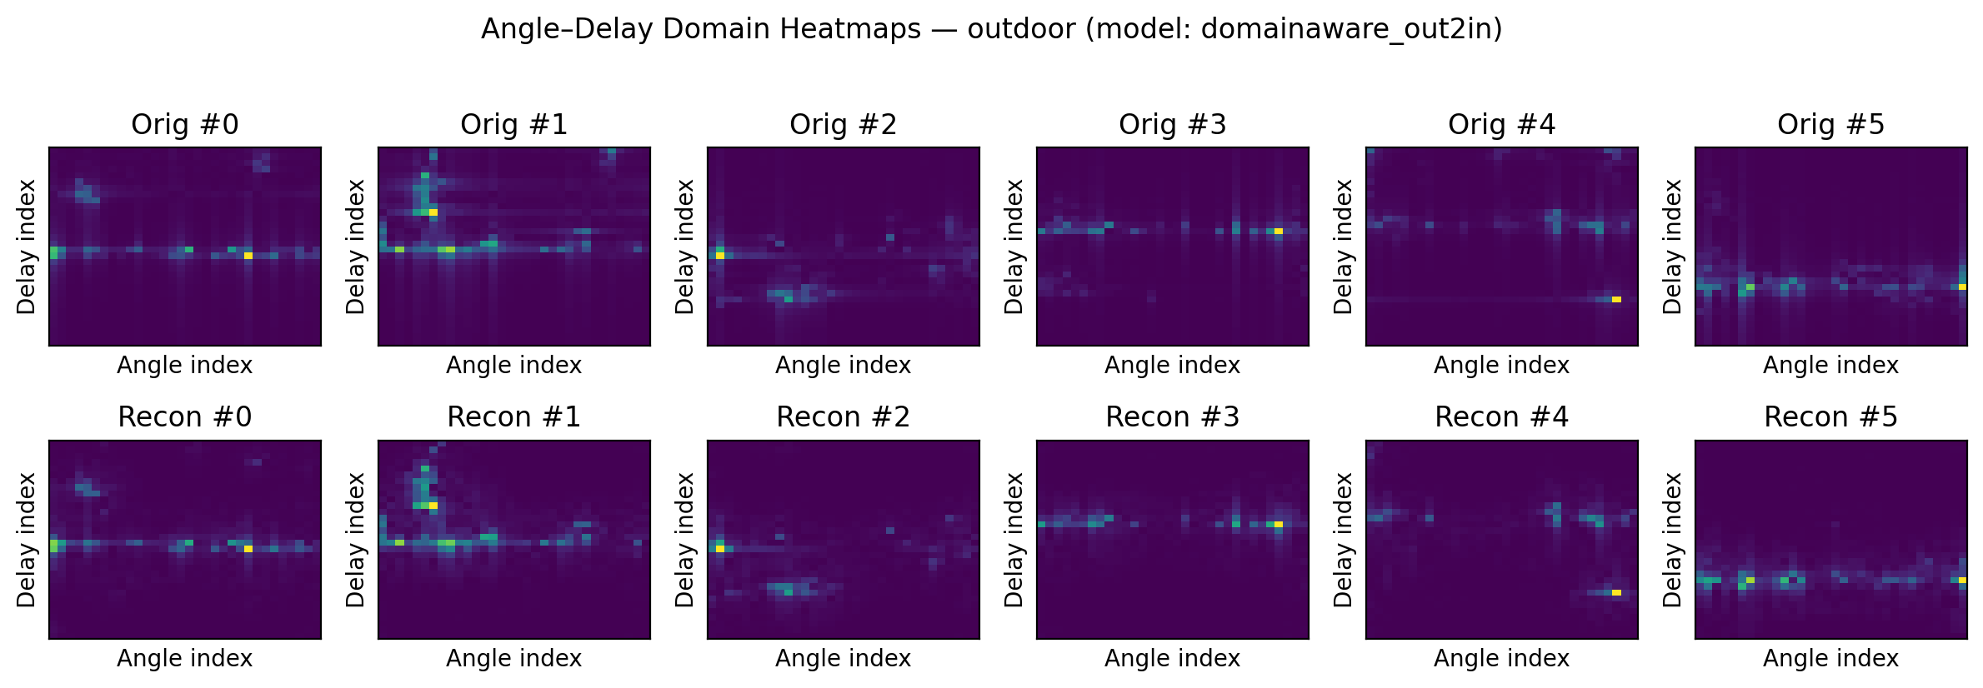
Test Set Exemplary Heatmaps
Indoors evaluation
(Indoor→Outdoor)
|(Outdoor→Indoor)
Outdoors evaluation
(Indoor→Outdoor)
|(Outdoor→Indoor)
28/30

Slide 29
Conclusions and future work
Angular domain is the main source of domain shift
CSINet struggles to generalize across different environments
Replay finetuning mitigates catastrophic forgetting
Domain-aware with ConvAdapters further improves adaptation
Latent-invariant features through contrastive learning
Explore foundation models and transformer-based architectures
In the real world for CSI compression TX-RX are involved
Gradients are not perfect!
29/30

Slide 30
References
[1] Wen, C. K., Shih, W. T., & Jin, S. (2018). Deep learning for massive MIMO CSI feedback. IEEE Wireless Communications Letters, 7(5), 748-751.
[2] GitHub - sydney222/Python_CsiNet: Python code for "Deep Learning for Massive MIMO CSI Feedback“
[3] Dataset: COST2100 (used in original CSINet paper)
[4] Liu, L., Oestges, C., Poutanen, J., Haneda, K., Vainikainen, P., Quitin, F., ... & De Doncker, P. (2012). The COST 2100 MIMO channel model. IEEE Wireless Communications, 19(6), 92-99
[5] Mohsin, M. A., Umer, M., Bilal, A., Jamshed, M. A., & Cioffi, J. M. (2025). Continual Learning for Wireless Channel Prediction. arXiv preprint arXiv:2506.22471
[6] Houlsby, N., Giurgiu, A., Jastrzebski, S., Morrone, B., De Laroussilhe, Q., Gesmundo, A., ... & Gelly, S. (2019, May). Parameter-efficient transfer learning for NLP. In International conference on machine learning (pp. 2790-2799). PMLR
[7] Rebuffi, S. A., Bilen, H., & Vedaldi, A. (2017). Learning multiple visual domains with residual adapters. Advances in neural information processing systems, 30.
30/30

Slide 31
Thank you for your attention!

Slide 32
Backup slides

Slide 33
Dataset Processing
Dataset and GitHub inspection (CSINet) reveal the applied normalization strategy
CSI is already transformed into the angular–delay domain (32 × 32)
Obtained via DFT across subcarriers (delay domain)
And DFT across antennas (angular domain)
This is the standard representation used in CsiNet-based compression
CSI values are shift-normalized
Stored as real_raw + 0.5, imag_raw + 0.5
Ensures all stored values are within [0, 1]
For analysis, we denormalize by subtracting 0.5
Restores CSI to [-0.5, 0.5] range in both real and imaginary parts
Required to correctly analyze magnitude, delay profiles, and angular structure

